Slide 1
Online Retail Data
Presentation

Slide 2
The Findings based on these questions
Presenting the complete storytelling of the data as per my findings on my previous task based on these four questions below.
Which region is generating the highest revenue, and which region is generating the lowest?
What is the monthly trend of revenue, which months have faced the biggest increase/decrease?
Which months generated the most revenue? Is there a seasonality in sales?
Who are the top customers and how much do they contribute to the total revenue? Is the business dependent on these customers or is the customer base diversified?

Slide 3
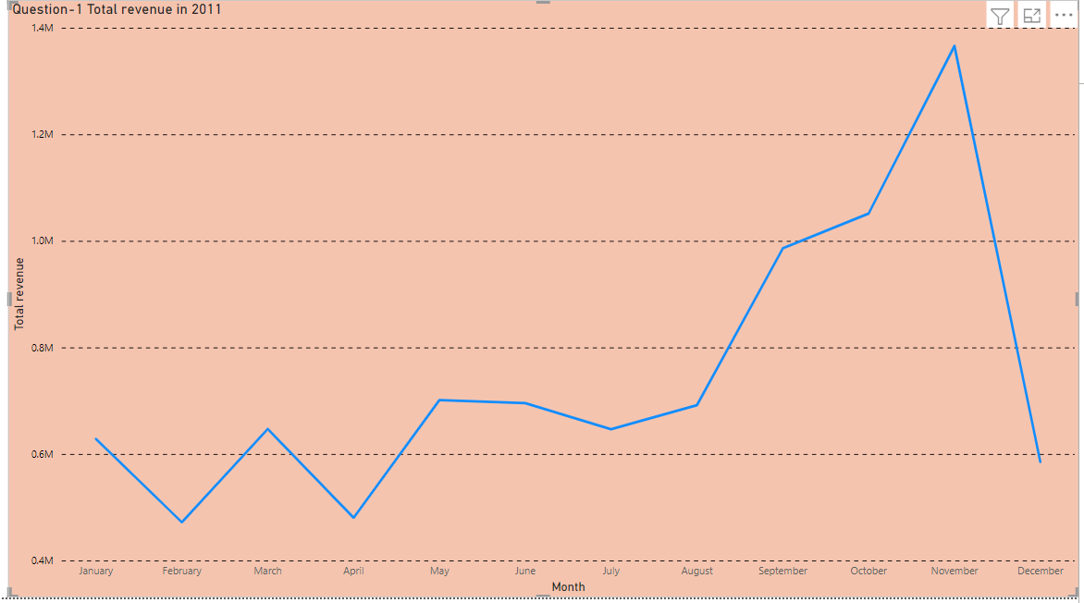
Visual 1- Total revenue in 2011
In this finding we can see the total revenue of every month in 2011.
My first priority to clean the data to find the root cause.
Steps I followed.
I have checked the quantity should not be below 1 unit.
And the Unit price should not be below $0.
Multiplied the quantity from unit price and get the total revenue.

Slide 4
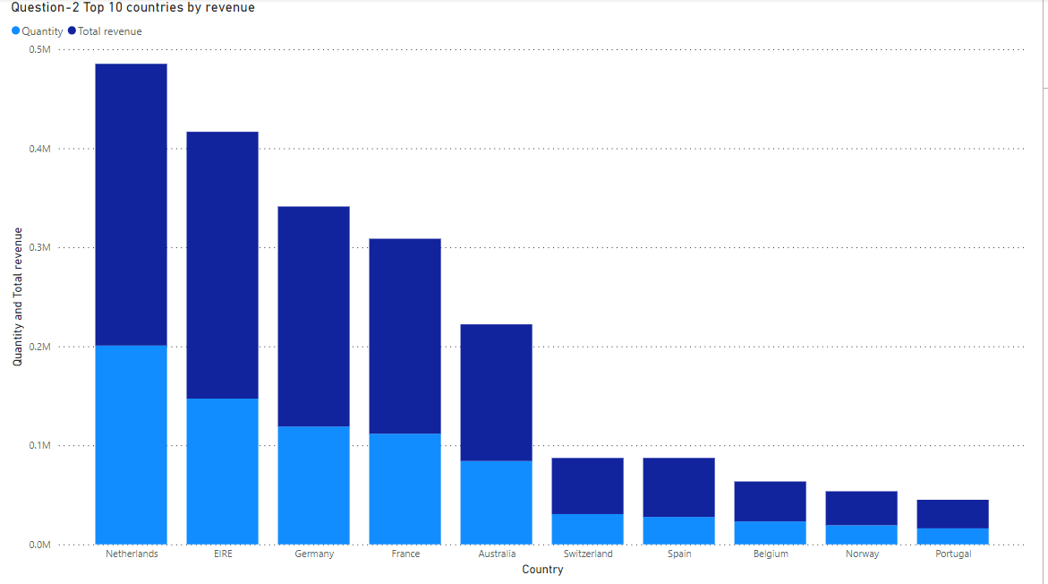
Visual 2- Top 10 Countries by Revenue
The Country generates the highest revenue.
In this finding we can see the top 10 countries total revenue and product quantity.
United kingdom has been excluded as per the instructions.
The Netherlands purchased the most products and generated the highest revenue.
Using the bar chart to show the quantity and revenue of each region.
Dark blue represents Revenue, and sky blue color represents quantity,

Slide 5
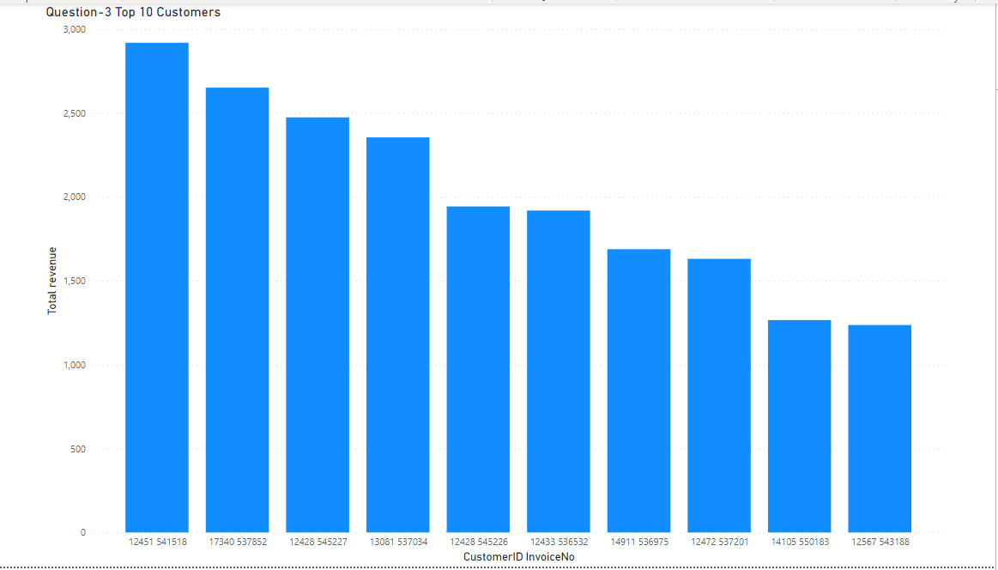
Visual-3 Top 10 Customers
The top customers and how much do they contribute to the total revenue.
1- I have created a column chart or a vertical bar chart where each bar would represent the revenue generated by the customers.
2- The customers will be identified from the field “CustomerID” and InvoiceNo. Make sure that the customers who do not have any customer IDs.
3- Excluded who doesn’t have customer ID.

Slide 6
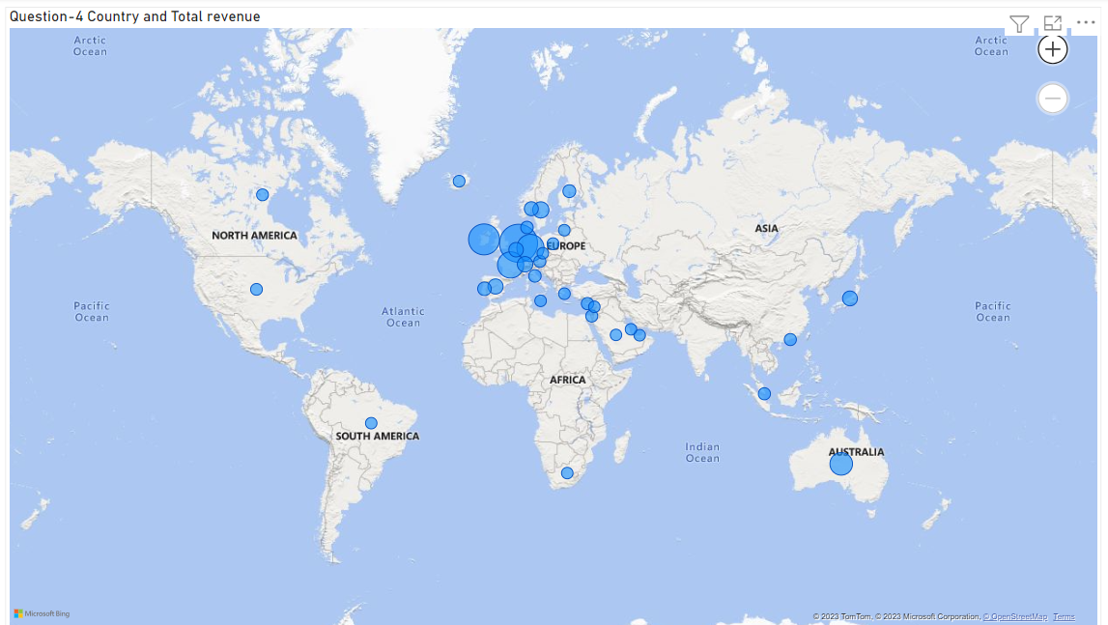
Visual-4 Total Revenue by Region
This visual highlights each country and shows the total number of units sold or the name of the country.
The blue bubbles highlights the revenue in each country.
UK has been excluded from this visual.

Slide 7
THANK YOU

